Slide 1
ORGANO METALLIC CHEMISTRY

Slide 2
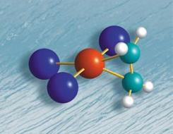
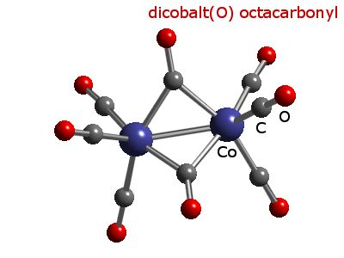
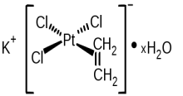
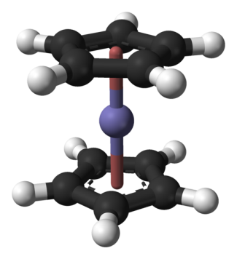
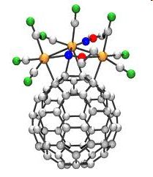
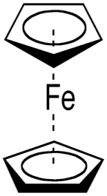
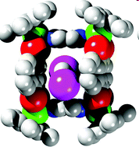
Organometallic Chemistry
Organometallic Chemistry
An area which bridges organic and inorganic chemistry
A branch of coordination chemistry where the complex has one or more metal-carbon bonds
The metal-ligand interactions are mostly π acid type
M-C bond can be a σ type or π type bond

Slide 3
The number of atoms through which a ligand bonds is indicated by the Greek letter η (eta) followed by a superscript indicating the number of ligand atoms attached to the metal. For example, because the cyclopentadienyl ligands in ferrocene bond through all five atoms, they are designated η 5 -C5H5. The formula of ferrocene may therefore be written (η 5 -C5H5)2Fe. The η 5 -C5H5 ligand is designated the pentahaptocyclopentadienyl ligand. Hapto

Slide 4
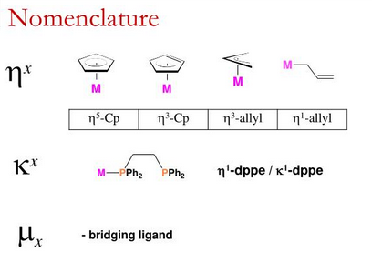

Slide 5
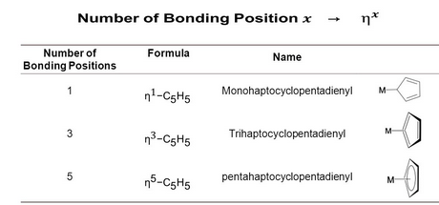

Slide 6
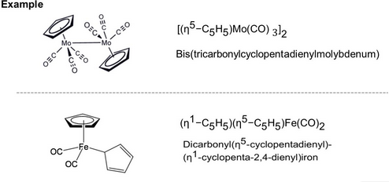

Slide 7
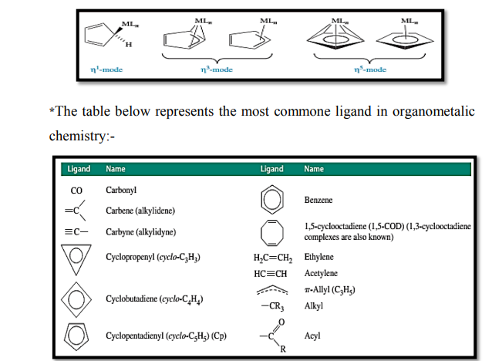

Slide 8
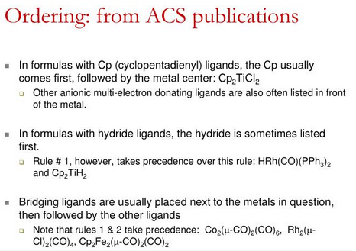

Slide 9
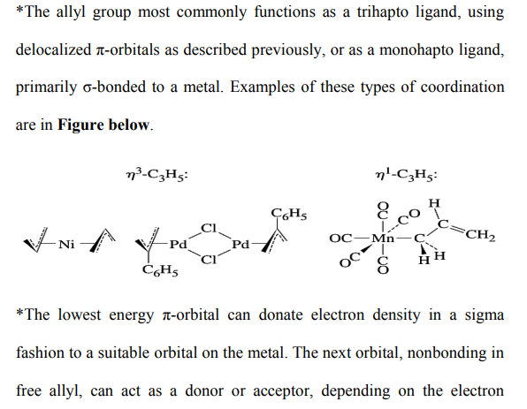

Slide 10
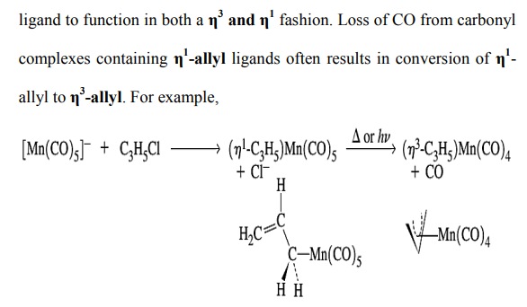

Slide 11
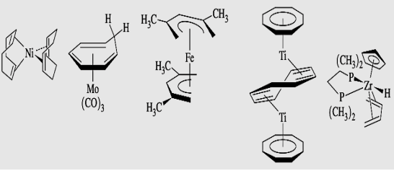

Slide 12
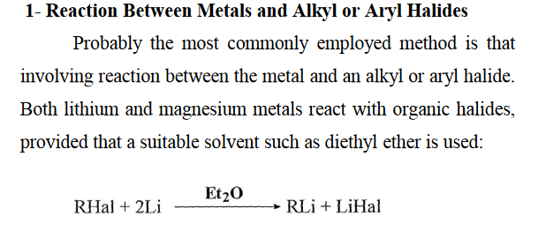
SYNTHETIC METHODS:
There are many ways of generating metal to carbon bonds that are useful for both nontransition and transition metals. Some of the more important are as follows:

Slide 13
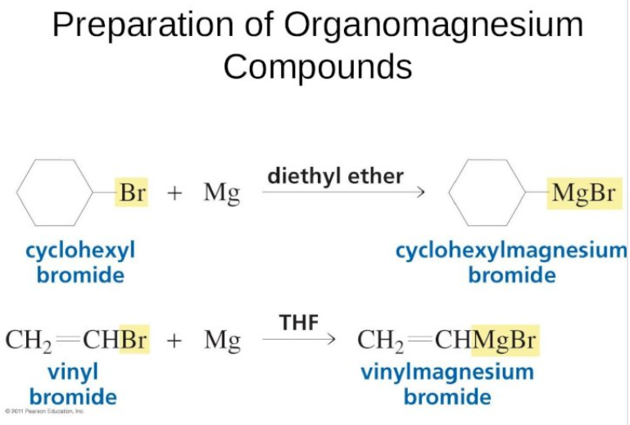
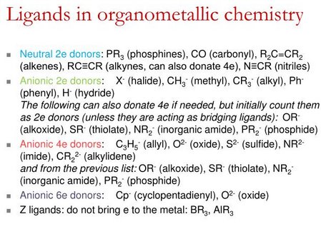

Slide 14
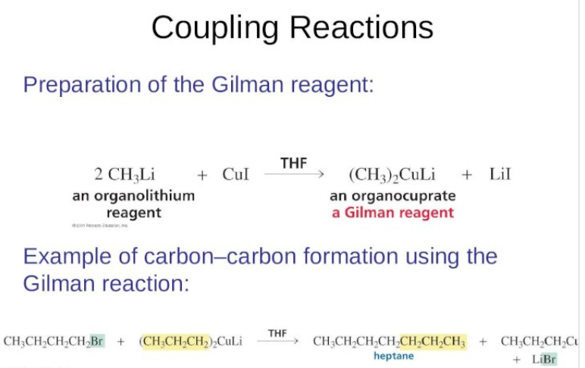
2- Reaction between metal halides and other organometallic compounds (use of alkylating agent)

Slide 16
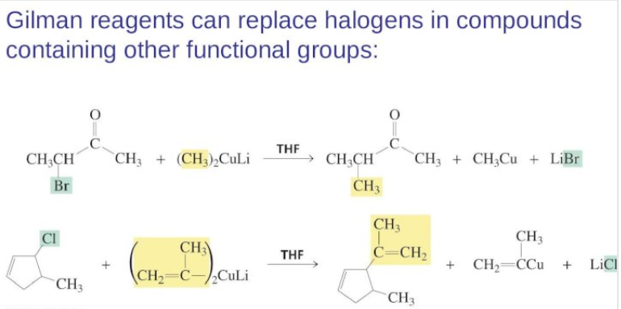

Slide 17
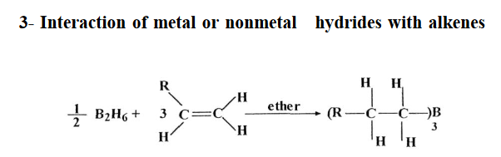

Slide 18
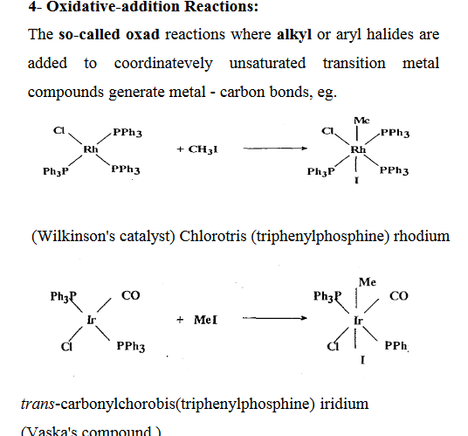

Slide 19
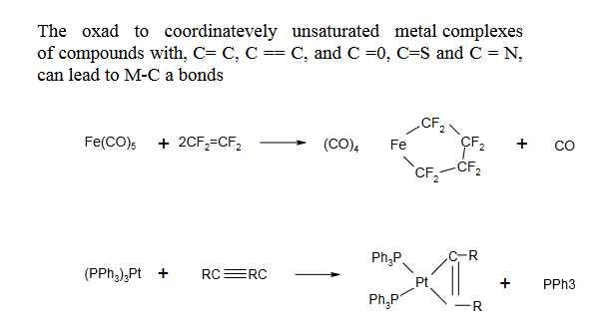

Slide 20
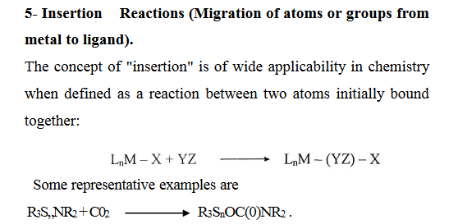

Slide 21
